Slide 1
Trends in Nitrate Concentrations in Public Water-Supply Wells, Suffolk County, New York, 1982-2008
Irene J. Fisher
and
Patrick J. Phillips
U.S. Geological Survey
21st Long Island Geologists Conference
Stony Brook University
April 12, 2014

Slide 2
Points of Interest:
Groundwater is our sole source of drinking water
Groundwater is considered to be an important source of nitrogen to coastal waters
Previous studies have indicated potential increase in nitrate over time
Long-term quantitative assessments tend to be rare
Quantitative assessment can aid in targeting important groundwater contributions

Slide 3
Statistical analysis background
700+ SCWA wells over the last 50 yrs were scanned for which suitable and sufficient data exist between 1982-2008
264 wells (95 Magothy; 169 upper glacial) were used in the statistical analysis for trend
Representative value (nitrate concentration) for each well
Two time periods:
  Long Term (1982-2008) Mann-Kendall
  Short Term (1982-1994) Mann-Kendall
Regional Kendall

Slide 4
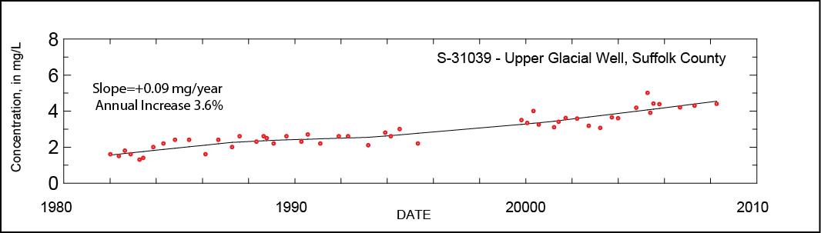
Long Term Groundwater Nitrate Trends
Suitable data spans between 1982 to 2008
Break in data between the years 1997 to 1999

Slide 5
Percentage of wells with increasing, decreasing, or no discernable trend
UPPER GLACIAL AQUIFER
MAGOTHY AQUIFER
100
126
66
59
Long
Short
Long
Short
> 75 % of wells in both aquifers have increasing, long term trends
> 40% of wells in both aquifers have increasing, short term trends

Slide 6
Nitrate Concentration Ranges
Upper Glacial Aquifer
Long Term
Short Term
low
moderate
high
low
moderate
high
low: < 1 mg/L
moderate: > 1 mg/L to < 5 mg/L
high: > 5 mg/L

Slide 7
Nitrate Concentration Ranges
Magothy Aquifer
Long Term
Short Term
low
moderate
high
low
moderate
high
low: < 1 mg/L
moderate: > 1 mg/L to < 5 mg/L
high range: > 5 mg/L

Slide 8
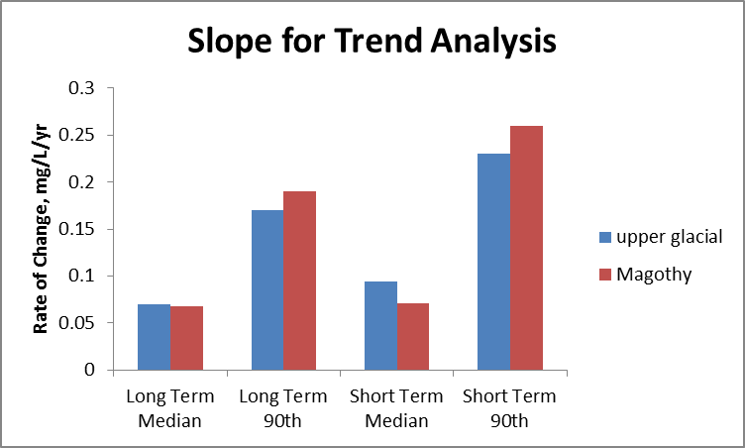
Rate of Change
Aquifer Period Median 90th percentile
UGL LT 0.070 0.17
UGL ST 0.094 0.23
MG LT 0.068 0.19
MG ST 0.071 0.26
Median: general tendency
90th: highest rate of change
Some wells are increasing at a rate of 2 mg/L over a decade

Slide 9
Regional-Kendall test
Assessment of whether a consistent trend occurs at many of the sampling locations within a region
Inclusion of uncensored data only
Five regions based on sewerage, land use (including population density), and hydrogeologic factors
  Northwest (NW)
  Southwest unsewered (SW-UN)
  Southwest sewered (SW-SE)
  Central (CE)
  Eastern (EA)

Slide 10
Upper Glacial Aquifer,
Long Term (1982-2008)
Map & bar chart
Regional
Trend
EA
NW
CE
SW-UN
SW-SE
Increasing trend
Decreasing trend
No trend

Slide 11
Upper Glacial Aquifer,
Long Term (1982-2008)
Map & bar chart
Number of
wells
in region
EA
NW
CE
SW-UN
SW-SE
Increasing trend
Decreasing trend
No trend

Slide 12
Upper Glacial Aquifer,
Long Term (1982-2008)
Increasing trends for 3 of the regions
> 70% of wells in NW and CE have increasing trends
25% of wells in EA have decreasing trends
Map & bar chart
EA
NW
CE
SW-UN
SW-SE
Increasing trend
Decreasing trend
No trend

Slide 13
Upper Glacial Aquifer,
Short Term (1982-1994)
Increasing trends for 3 of the regions
70% of wells in NW have increasing trends
EA
NW
CE
SW-UN
SW-SE
Increasing trend
Decreasing trend
No trend
P

Slide 14
Magothy Aquifer,
Long Term (1982-2008)
4 out 5 regions have increasing trends
1 well had a decreasing trend
CE
EA
NW
SW-UN
SW-SE
Increasing trend
Decreasing trend
No trend

Slide 15
Magothy Aquifer,
Short Term (1982-1994)
3 regions have increasing trends
No wells exhibited a decreasing trend
NW
CE
EA
SW-UN
SW-SE
Increasing trend
Decreasing trend
No trend

Slide 16
Summary
This analysis only included SCWA wells
Many wells have significant increasing trends in nitrate concentrations, more so in the Magothy than the upper glacial
The long term analysis (1982-2008) has the greatest number of wells with increasing trends for both aquifers
Most of the representative concentrations for any of the analyses are in the moderate range (> 1mg/L to < 5 mg/L)
Some wells have an increase in nitrate concentrations at the rate of 2mg/L per decade
There were no regional trend decreases for any of the analyses
Two regions, NW and CE, have regional trend increases for each aquifer and time period
Future analysis will include an assessment of the pumpage management for the same time periods

Slide 17
For more information
Irene J. Fisher ifisher@usgs.gov
Patrick J. Phillips pjphilli@usgs.gov
Troy Program Office
USGS New York Water Science Center
Coram, NY 11727
(631) 736 - 0783

